Slide 1

Credit One Project
Predicting Customer Credit Limits
Ariel E. Vargas Solano

Slide 2
Business understanding:
Statement of the goals
Investigate loan default issues.
Explored the factors influencing loan payment defaults.
Determine how much each factor contribute to the default loan clients.
Propose a model for predicting default of loan clients.

Slide 3
Process Framework
The framework established by Zumel and Mount will be applied to outline the steps to be followed through the analysis of the data found in the Credit One database.
Steps:
Define goal
Collect and manage data
Build the model
Evaluate and critique the model
Present results and document
Deploy and maintain the model
The Zumel and mount framework is as good as BADIR, yet the first one proves to establish a more common and effective business language for both the user and those to whom it is being presented.

Slide 4
Data Exploration
Source: MySQL external database
Structure:
Variable | Description
ID | ID of each client
LIMIT_BAL | Amount of the given credit in NT Dollars (includes individual and family/supplementary credit)
SEX | Gender (1 = male, 2 = female)
EDUCATION | (1 = graduate school, 2 = university, 3 = high school, 0, 4, 5, 6 = others)
MARRIAGE | Marital status (1 = married, 2 = single, 3 = divorce, 0 = others)
AGE | Age in years
PAY 0-6 | Payment status in September-April 2005 (-2 = no consumption, -1 = paid in full, 0 = revolving credit, 1 = payment delay for one month, … , 9 = payment delay for nine months
BILL_AMT 1-6 | Amount of bill statement in September-April 2005 (NT Dollar)
PAY_AMT 1-6 | Amount of previous payment in September-April 2005 (NT Dollar)
DEFAULT PAYMENT NEXT MONTH | Default payment (1 = yes, 0 = no)

Slide 5
Data Management
Steps:
Importing data from MySQL database into Panda's data frame.
Understanding of each variable.
Data cleaning and preprocessing.
Exploratory data analysis: investigating the data set and summarize the main characters.
Comparisons of data mining techniques for the predictive accuracy of probability of default of loan clients.

Slide 6
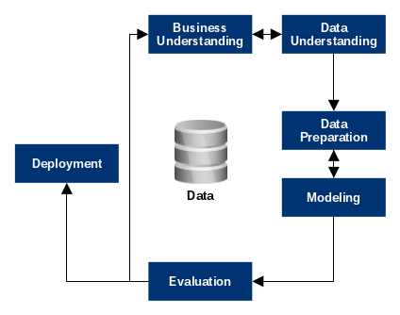
Flowchart Process
The business, the problematic, the source of data extraction, the function of each variable and the framework to be used must be well understood.
We will look for duplicate data, missing values, categorization of variables, etc…
Results should be well summarized, with graphical visualization and the storytelling must be well prepared.
More than one type of learning model should be applied to compare which has the best prediction accuracy.
Notes:
La región del oeste gasta más con un promedio de 1283$
La región del sur es la que gasta menos con un promedio de 253$
Comprender y contrastar el porqué en la región del oeste realizan compras más altas que las demás regiones.
Utilizar técnicas y estrategias de marketing en todas las regiones para obtener/emular resultados semejantes a los de la región del oeste.

Slide 7
Initial Insights from the data
Some corrections must be made to the data base.
  There are categorical variables that have more than the unique values stated in their description.
  Replacement of some variable’s unique values representation (Sex, Education, and default payment).
A 22.1% of the total loans given are categorized as default payments.
  The objective of this project is to implement a model with the capacity of reducing the risk of default payments.
Notes:
La región del oeste gasta más con un promedio de 1283$
La región del sur es la que gasta menos con un promedio de 253$
Comprender y contrastar el porqué en la región del oeste realizan compras más altas que las demás regiones.
Utilizar técnicas y estrategias de marketing en todas las regiones para obtener/emular resultados semejantes a los de la región del oeste.

